Slide 1
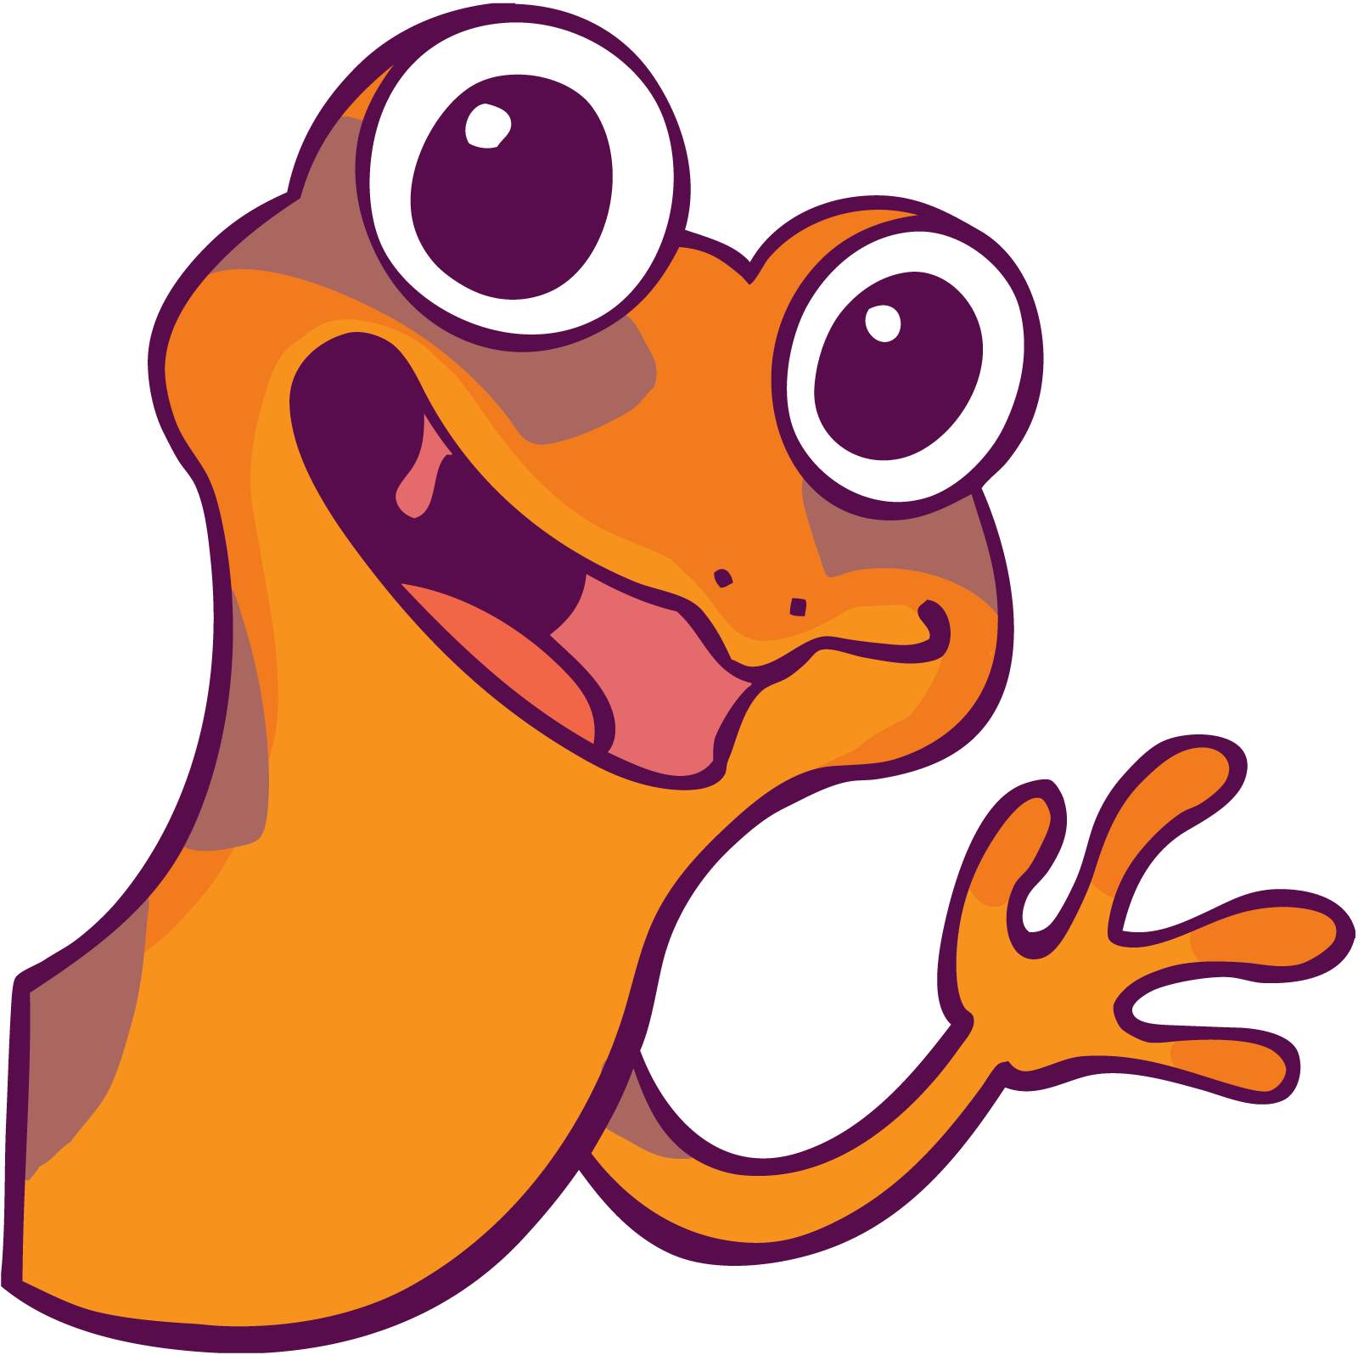
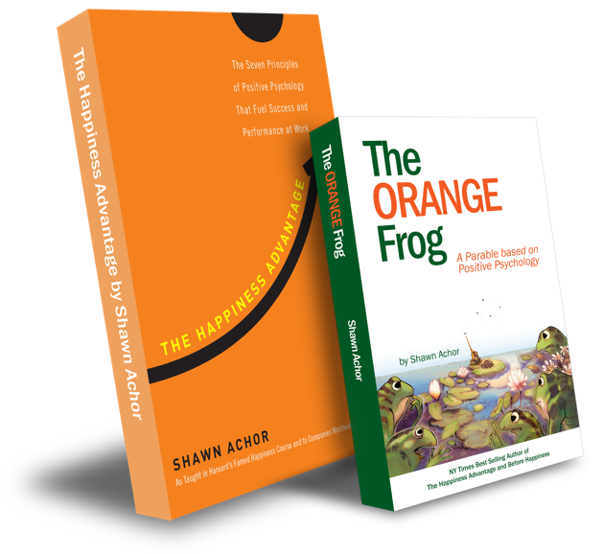
The Orange Frog
The Fun 15

Slide 2
Week Three

Slide 3
The Fun Fifteen
Learning Objective:
I can identify what kinds of exercise interest me
I will discuss the importance of knowing what I like, so I will continue to do it.
Notes:
Standard:
Essential Concept and/or Skill: Communicate and work productively with others emphasizing collaboration and cultural awareness to produce quality work.
Interact positively as a team member.
Cooperate with others in a group setting.
Generate ideas with group members.
Are active listeners.
Read and understand information in a variety of forms.
Express ideas.
Skill:
Active listening, express ideas

Slide 4
Skills
Self Management
Responsible decision making

Slide 5
“Do you exercise on a regular basis?”
Do you know a form of exercise you can do daily?

Slide 6
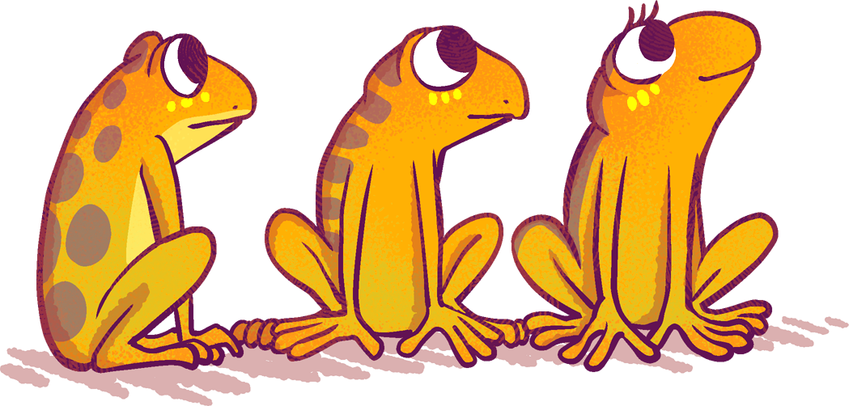
Thoughts
When we exercise, there are things that happen to our body and our brain. Our body can become tight from stress. When we exercise, or move our body, that tightness will sometimes go away. That means that we can be more relaxed and therefore, happier. There are scientific things that happen in your brain when you exercise that create happiness. When we exercise, it’s like we are telling our brain and our body, that we matter, and we’re important.

Slide 7
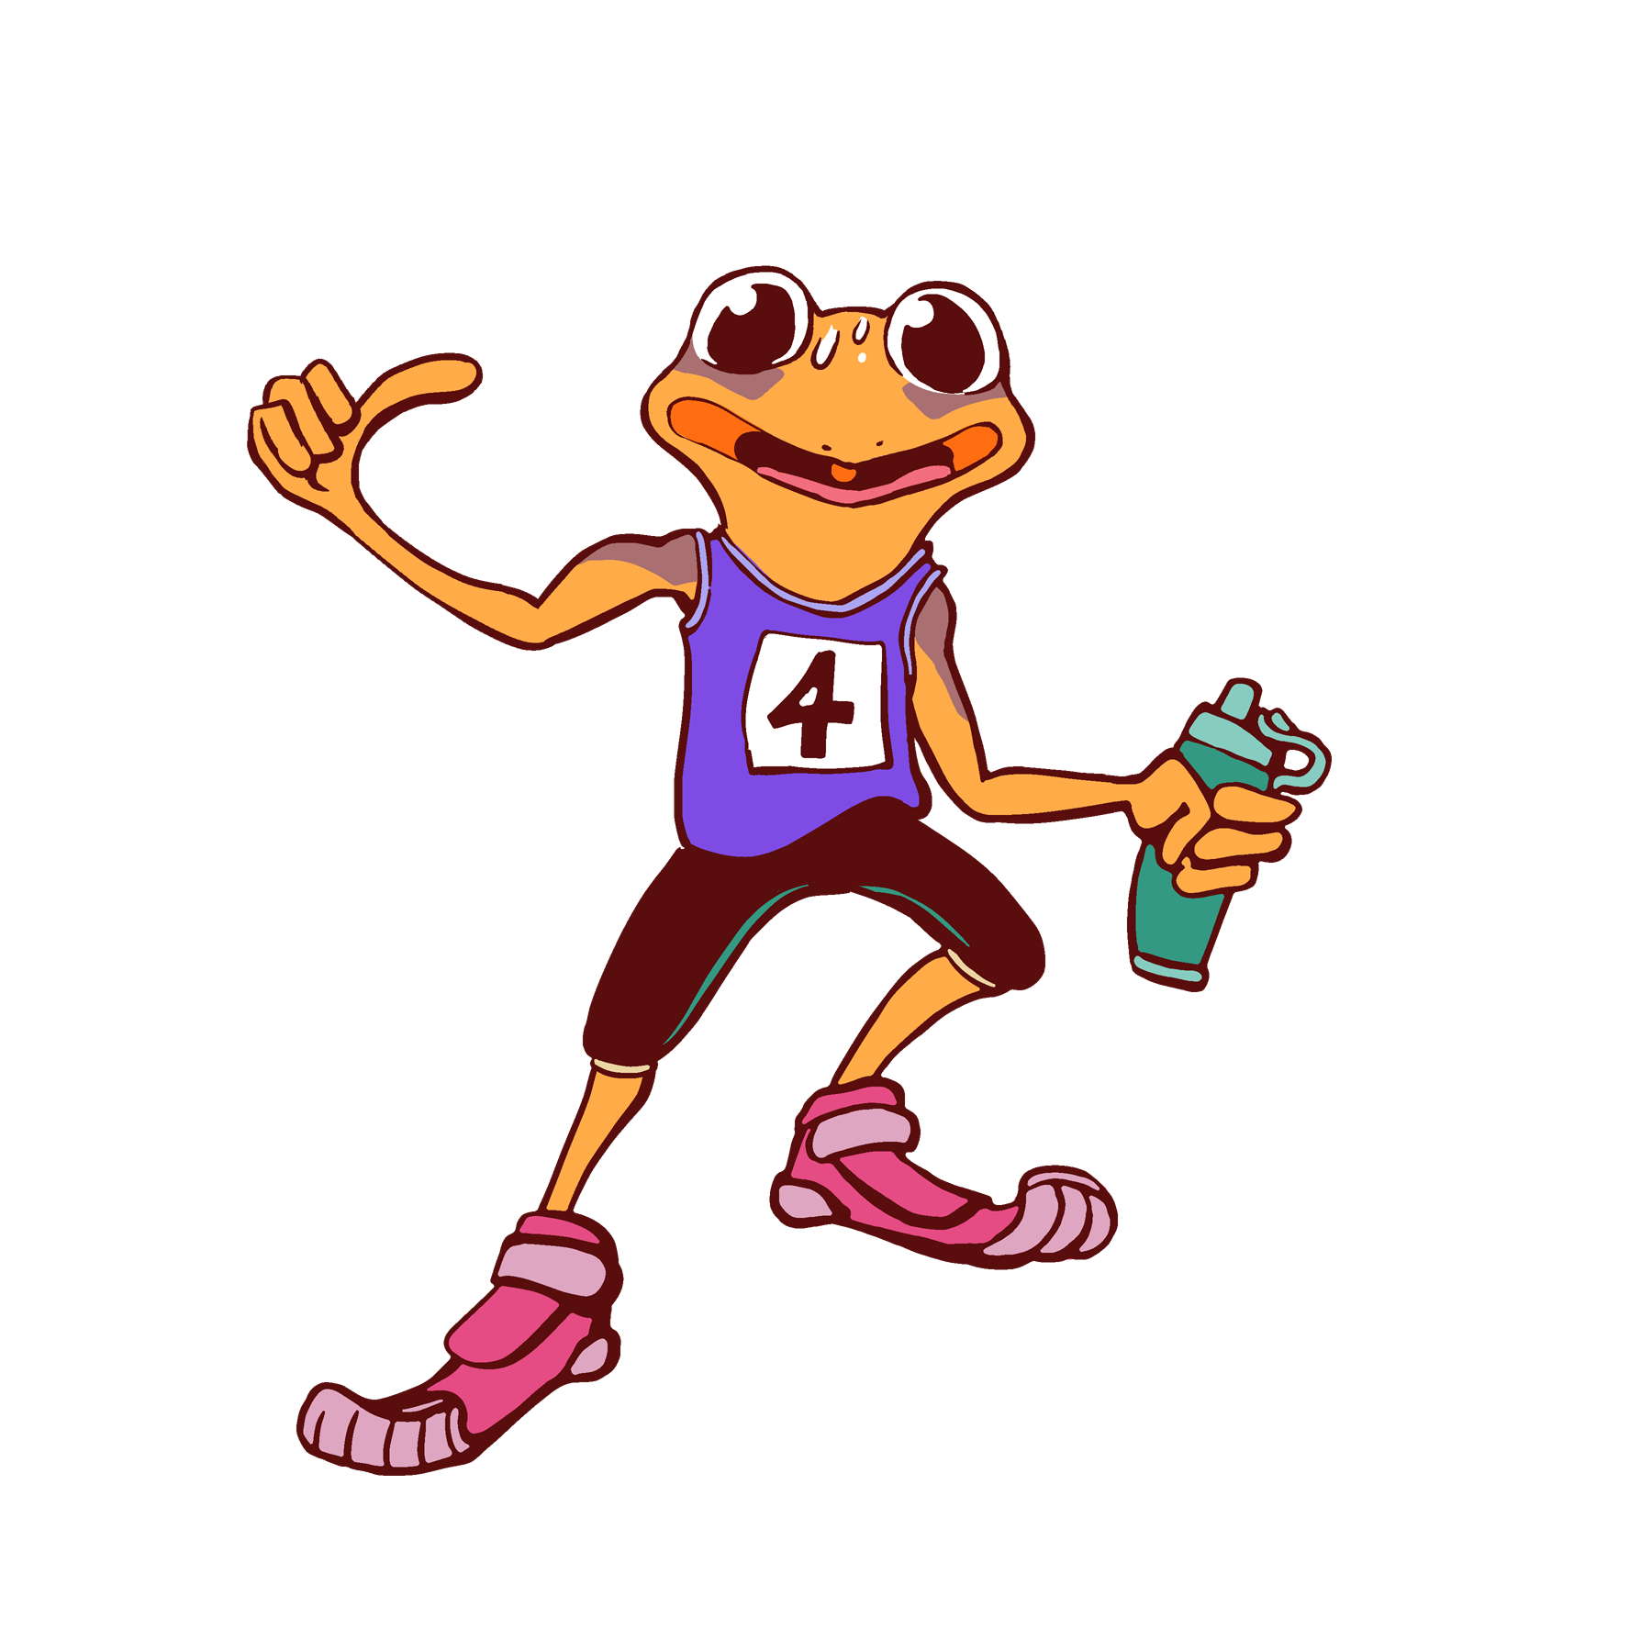
Activity
Part of understanding that exercise can create happiness for you, is also seeing that exercise can be fun.
There are lots of people who feel that exercise is a chore and isn’t fun.
What would it look like to decide what your favorite kind of exercise is?
Notes:
There is a worksheet available to use for the kinds to fill out digitally or printed.

